Slide 1
Current Regulatory Concerns
Mark Acton, Commissioner
Postal Regulatory Commission
May 10, 2012

Slide 2
Thanks
Art Sackler, Executive Director National Postal Policy Council
Chuck Fattore, Donnelley Logistics (Chair)
Familiar faces and friends I have yet to meet – My 5th visit to NPPC
Notes:
Mark the last powerpoint said it was your 4th so I added-obviously not a critical point. The website shows Fattore as chair

Slide 3
Summary of Content
Pending Legislation
FY-2013 Budget Proposal
701 Report and Recommendation
Annual Compliance Determination Findings
Consideration of Technical Methods to Apply in
Workshare Discount Design
Post Office Closure Appeals
PRC/USPS Periodical Study
Peak Load Study

Slide 4
summary of content (cont.)
Mail Processing Network Rationalization
Service Changes
Proposed USPS Service Standards
PRC Stakeholders Process

Slide 5
Pending Legislation
S. 1789, The 21st Century Postal Service Act, as amended passed the Senate April 25, 2012
H.R. 2309 Postal Reform Act of 2011
Various other bills taking various approaches to ensure USPS sustainability
USPS contends S. 1789 does not “provide the Postal Service the speed and flexibility it needs to achieve $20 billion in cost reductions” by 2015
CBO score—
S. 1789 cost of $6.3 billion over 10 years
H.R. 2309 net savings of $18.5 billion over 8 years

Slide 6
FY 2013 Budget Proposal
Restructure RHB pre-funding
Refund FERS surplus
5-day delivery starting in 2013
Increase collaboration with state & local governments
Align costs and seek balance of exigent increase

Slide 7
701 Report & Recommendations Issued September 22, 2011
Highlights:
Stabilize postal finances by adjusting current Retiree Health Benefit Fund payment schedule, using Commission’s report on the USPS over-funded Civil Service Retirement system
Allow the Postal Service to add new market dominant classes of mail in order to adapt to rapidly changing needs of mail users and the postal system
If Congress decides to let the Postal Service offer new nonpostal services those services should be subject to appropriate regulatory oversight and review-ensuring that USPS offers profitable nonpostal services without disrupting the competitive marketplace
Encourage innovation by raising maximum revenue limits for market tests of experimental products.

Slide 8
Annual Compliance Determination FY 2011
Commission findings for FY 2010 Annual Compliance Determination issued 3/28/2012
The Postal Service lost $5.1 billion in FY 2011, but the loss would have been $10.6 billion had Congress not deferred the RHBF payment at the end of FY 2011.
First-Class Mail declined by 5 billion pieces in FY 2011 resulting in the Postal Service losing $1.0 billion in contribution to institutional costs

Slide 9
Annual Compliance Determination Findings (continued)
Pricing:
Ten market dominant products failed to generate
revenues sufficient to cover attributable costs, losing in the aggregate $1.6 billion, including:
$609 million from Periodicals,
$643 million from Standard Mail Flats, and
$112 million from Standard Mail Parcels/Non- Flat Machinables (NFMs);

Slide 10
Annual Compliance Determination Findings (continued)
Service Measurement:
The Postal Service is demonstrating success in meeting its service standard goals in the areas of single-piece First-Class Mail and Special Services. However, the Postal Service did not meet its delivery service standard target for the majority of market dominant products in FY 2011.
Full text of FY2010 ACD at: www prc.gov

Slide 11
Consideration of Technical Methods to be Applied in Workshare Discount Design
ORDER NO. 1320 (Worksharing)
This order evaluates and resolves several important issues related to PAEA provisions
affecting the proper pricing of workshare products.
The Commission found that savings from specific kinds of worksharing activities which depend on closely-related mailer preparation activities should be taken into account in the Postal Service’s savings estimates
The Commission adopts metered mail (includes metered, IBI and PVI letters) as the Base Group for calculating the costs avoided by Presort First-Class Mail
The Commission also found that the Postal Service saves some collection costs when First-Class Mail belonging to the new benchmark category is converted to the presort category
The Commission discussed the potential benefits of “bottom-up” costing proposed by certain mailer organizations, and what Postal Service data would need to be collected to make that costing approach succeed

Slide 12
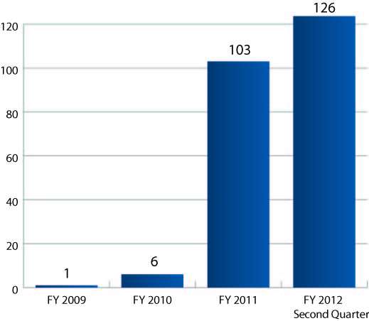
Post Office Closure Appeals

Slide 13
PRC/USPS Periodical Study
A joint PRC/USPS study was conducted which included visits to facilities to view periodicals processing, meetings with mailers, and the hosting of a webinar on cost issues related to Periodicals mail.
A joint report was developed an issued to Congress on October 13, 2011
HIGHLIGHTS OF THE REPORT
After review of Postal Service responses to data quality
recommendations from prior reviews, the Postal Service and the
Commission agree that the cost data are reasonably accurate for
ratemaking purposes.
Both the Postal Service and the Commission agree on the goal of
increasing automation to achieve cost savings.
The Postal Service estimated an upper bound of $146 million in potential savings
The Commission estimated potential savings of $349 million if the Postal Service processed Periodicals at the same expense as Standard Mail flats

Slide 14
Peak Load Study
On August 2, the Postal Regulatory Commission issued a Request for Proposal to produce a “Report on Peak Load Costs”
Peak load costs are traditionally thought of as additional costs that are born to cover higher demand than normal
Flexible cost models & pricing

Slide 15
Mail Processing Network Rationalization Service Changes
December 5, 2011 – Postal Service files case
Studying 223 processing facilities out of 476 for possible consolidation which will impact service
Realigning nationwide operations, processing and transportation network
Reducing mail processing equipment by as much as 50 percent
Dramatically decreasing the nationwide transportation network
Adjusting the workforce size by as many as 35,000 positions

Slide 16
Mail Processing Network Rationalization Service Changes
USPS estimates $1.6 billion net annual savings (Revised savings figures were provided last week)
Elimination of overnight service standard for significant portion of First-Class Mail and Periodicals- some impact on Standard and Package Services

Slide 17
Proposed USPS Service Standards
USPS proposed:
Now Proposed
Priority Mail: 1−3 days 1−3 days
First-Class Mail: 1−3 days 2−3 days
Standard Mail: 3−10 days 3−10 days
Periodicals: 1−9 days 2−9 days
Package Services: 2−8 days 2−8 days

Slide 18
Mail Processing Network Rationalization Service Changes
Complex request – testimony from 13 postal witnesses, 60+ library references, 25 intervenors
Hearings on direct testimony completed in March.
Rebuttal testimony received April 24, 2012.
Hearings scheduled for May 2012 on supplemental testimony and June 2012 for rebuttal testimony.
Report is scheduled for release later this summer

Slide 19
USPS Proposal Online
http://about.usps.com/news/electronic-press-kits/our-future-network/study-list-110915.pdf — A Facilities List
http://about.usps.com/news/electronic-press-kits/our-future-network/welcome.htm—Press Kit for the “Comprehensive Changes” Proposal

Slide 20
PRC Stakeholders Process
Establish Docket
Formal on-the-record Hearing Process
Submission of Testimony
Commission Analysis and Findings

Slide 21
www.prc.gov

